Slide 1

Tree Building and Phylogenetic Analysis
Kathryn Campbell

Slide 2
Schedule
Alignments & Understanding Trees 12:00-13:00
Alignments
Practical: Viewing and aligning sequences
Terminology
Tree building methods
Practical: Interpreting phylogenetic trees
Tree Building 14:00-15:00
Substitution models
Statistical support (bootstrapping, posterior probabilities)
Practical: Using modeltest and IQTREE2 to find the best substitution model and generate a maximum likelihood tree
Visualisation using FigTree
Annotating using metadata
Practical: Preparation of publication ready trees with appropriate annotation and bootstrapping in FigTree

Slide 3
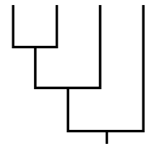
Why use phylogenies?
Molecular clocks e.g. “How long ago since two groups split?”
Ancestral state change e.g. “Movement rate between population A and B?”
Selection e.g. “Which genes or sites have undergone adaptive change?”
Demographic reconstruction e.g. “How has population size changed through time?

Slide 4
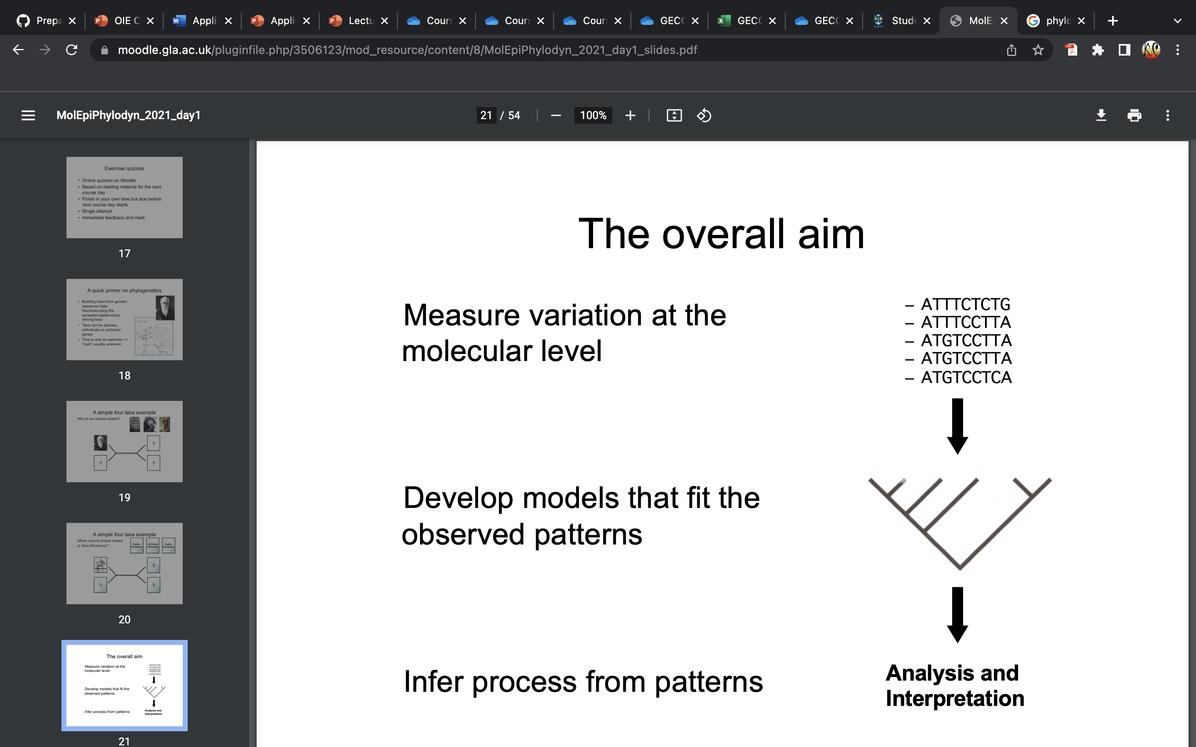
What is phylogenetics?
Building trees from genetic sequence data:
Reconstructing the ancestral relationships among taxa
Taxa can be species, individuals or particular genes
Tree is only an estimate => “truth” usually unknown
Measure variation at the molecular level
Develop models that fit the observed patterns
Infer process from patterns

Slide 5
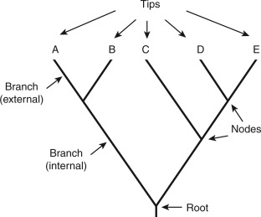
Parts of a phylogenetic tree

Slide 6
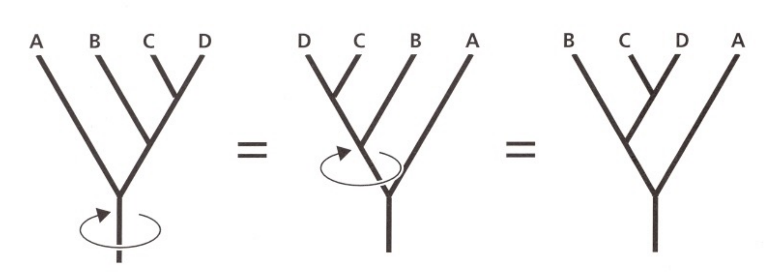
Branches can ‘swivel’

Slide 7
Vertical axis means nothing!
=

Slide 8
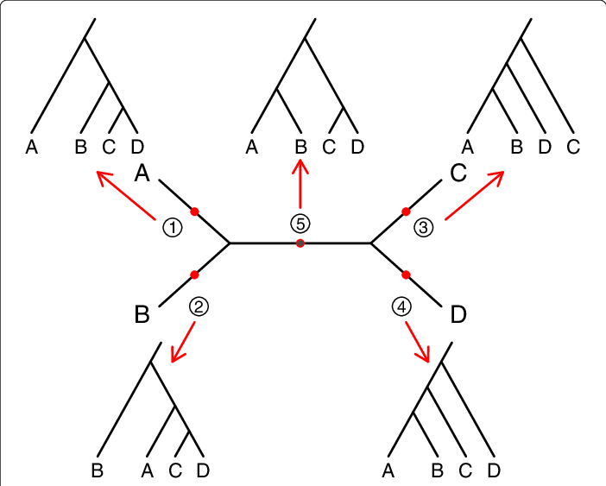
Rooting Trees
Midpoint Root

Slide 9
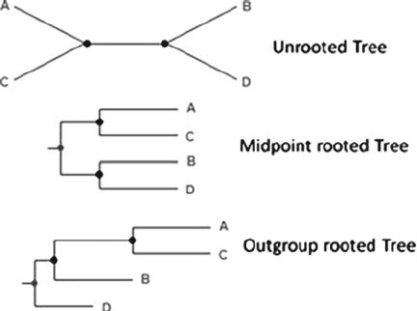
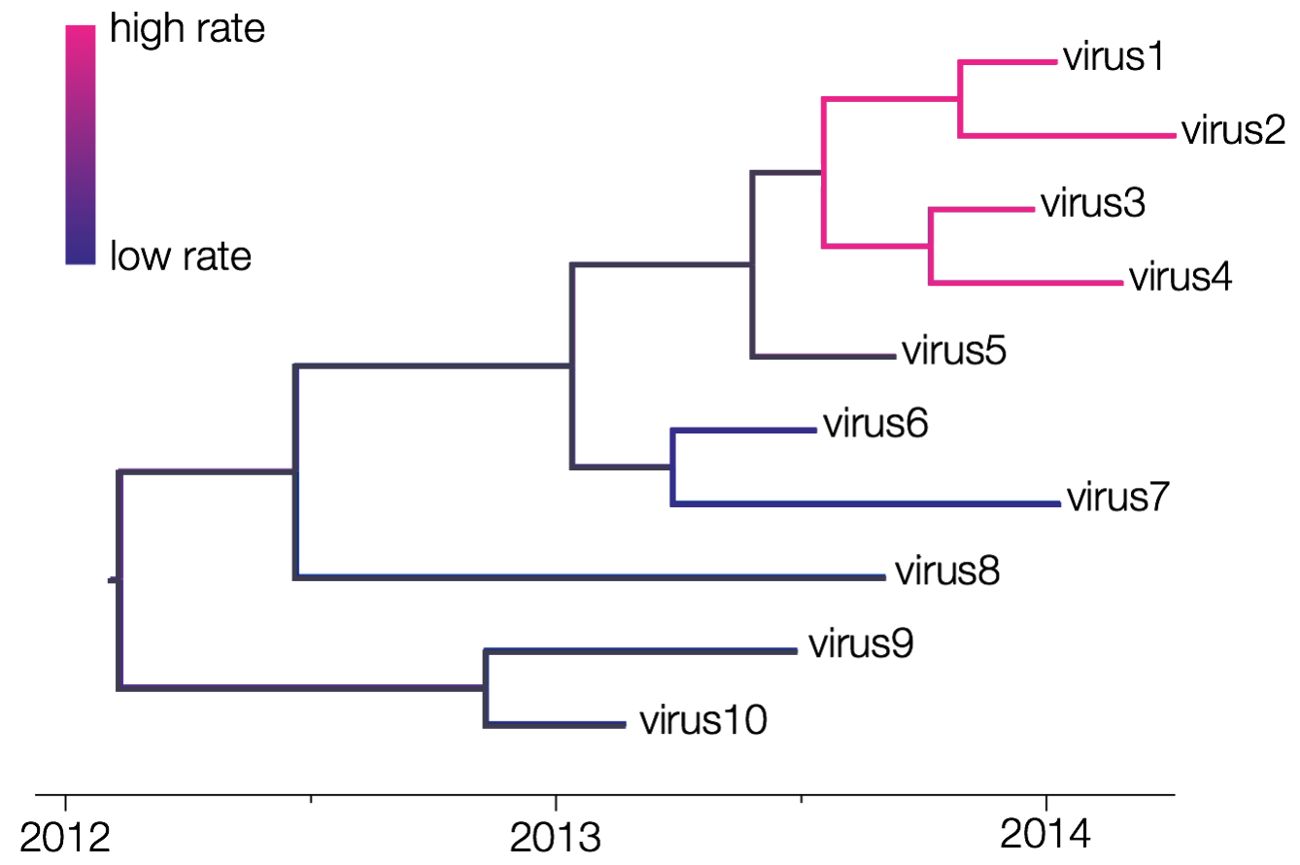
Rooting Trees
Remember this root could just as easily be put anywhere – it doesn’t represent anything!
Outgroup – one or more taxa that fall outside the group of interest
Molecular clock – oriented along an axis of time

Slide 10
Monophyletic
Monophyletic – sharing a single common ancestor
Not monophyletic
Clades, subclades and lineages are monophyletic groups of sequences of increasing levels of resolution

Slide 11
Interpreting phylogenetic trees - Practical
Follow the instructions in day4_tree_visualisation.md

Slide 12
Substitution models
Markov models that describe changes over evolutionary time
Attempt to predict the rate of substitution for nucleotides or amino acids at a given site, and also the distribution of substitutions across the entire sequence
Jukes-Cantor (JC)
all nucleotides occur at the same frequency and undergo change at the same rate
General Time Reversible (GTR)
Each type of nucleotide change occurs at its own rate (e.g. A->C =/= C->A)
Kimura 2-Parameter (K2P) and Kimura 3-Parameter (K3P)
Hasegawa-Kishono-Yano (HKY)

Slide 13
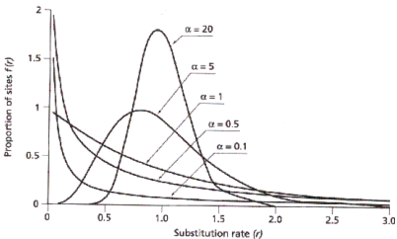
Variation among sites
Some sites undergo changes more frequently than others - can be expressed using a gamma distribution
Number of gamma categories
Slow
Fast
Some sites are are not allowed to change, as they have essential roles – these are called invariant sites

Slide 14
Interpreting Substitution Models
Substitution model – General Time Reversible
Allow invariant sites
GTR + F + I + G4
Empirical base frequencies
Gamma model with 4 rate categories

Slide 15
Tree Building Methods
Distance based
Maximum parsimony
Maximum likelihood
Bayesian methods

Slide 16
Maximum Likelihood
Maximize the probability of the sequences, given a tree and its branch lengths and an evolutionary model and its parameters
Important features
Allows full use of evolutionary models
Relies heavily on model chosen => can be misleading if there is much variation in the substitution process among lineages
Computationally much more demanding
IQTree

Slide 17
Bayesian Methods
Objective: determine the posterior distribution of trees given the sequence data
Based on this distribution, ‘best’ tree can be identified
Important features:
Allows full use of evolutionary models
Need to include priors
Posterior probabilities are approximated through Markov Chain Monte Carlo (MCMC) methods that sample from the posterior
Clade probabilities provide measure of uncertainty
BEAST

Slide 18
Bootstrapping
Artificial dataset of same size is generated by picking columns with replacement
Tree building applied to these bootstrap matrices
The frequency with which a node appears is taken as a measure of confidence for that node
ATGCAGGTA
ATGCTGCTA
ATGCAGCTC
TAGCAGGAC
ORIGINAL
AAGCCGGTA
AAGCCGCTA
AAGCCGCTC
TTGCCGGAC
GCGCAGGAA
GCGCTGCAA
GCGCAGCCC
GCGCAGGCC
ATAAGGTTT
ATTTGCTTT
ATAAGCTTT
TAAAGGAAA

Slide 19
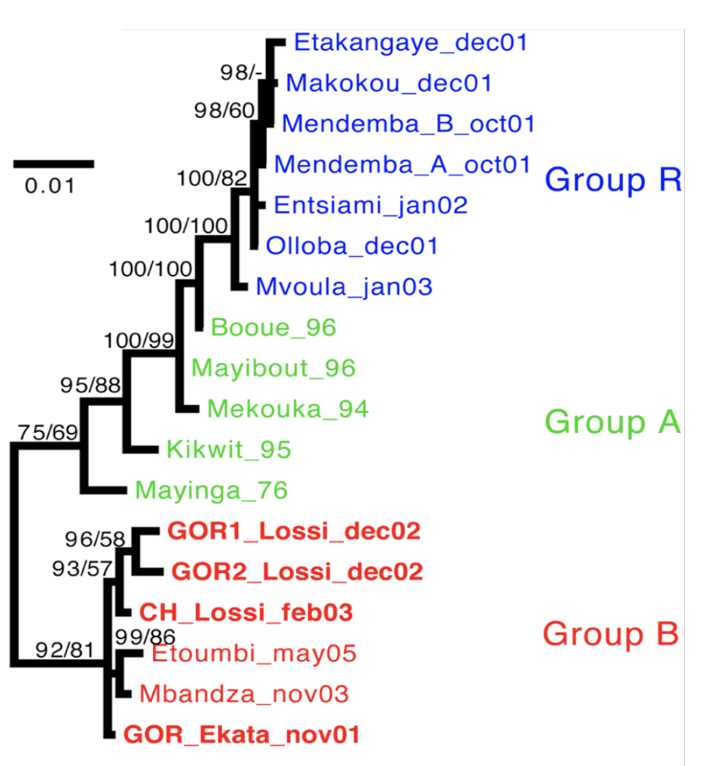
Posterior Probabilities
Count the frequency of a clade within the posterior distribution of trees
Less conservative: tend to be much higher than bootstrap values
Strong support:
Bootstrap >0.7
Posterior prob. >0.95

Slide 20
Phylogenetic Analysis Steps
Collect homologous sequences
Conduct multiple alignment
Fit an appropriate substitution model
Estimate tree(s) under that model
Test the reliability of the estimated tree(s)
Interpret and apply the phylogenetic tree
Potentially repeat steps 4-6 using different tree building methods and/or additional data

Slide 21
Phylogenetic Analysis Steps
Collect homologous sequences
Conduct multiple alignment
Fit an appropriate substitution model
Estimate tree(s) under that model
Test the reliability of the estimated tree(s)
Interpret and apply the phylogenetic tree
Potentially repeat steps 4-6 using different tree building methods and/or additional data
Follow the instructions in day4_tree_building.md

Slide 22
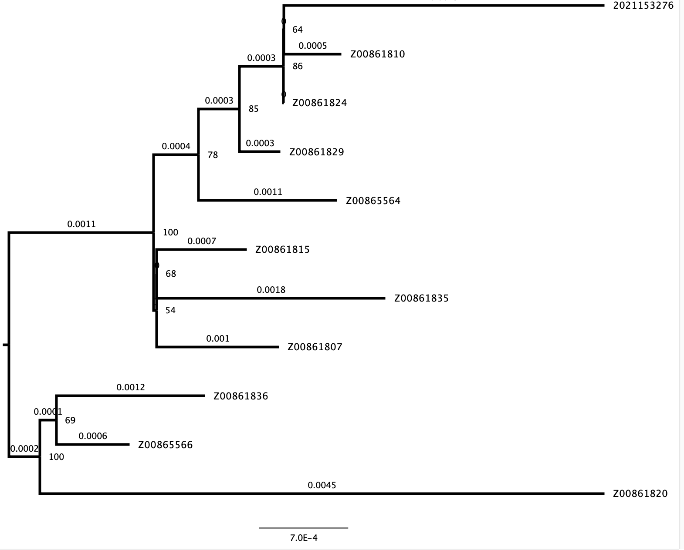
Visualizing Trees
Topology Changes:
Position of the root
“Swiveling” the branches
Ordering the nodes
Additional information:
Branch lengths
Node labels
Bootstraps
Node ages
Scale bar

Slide 23
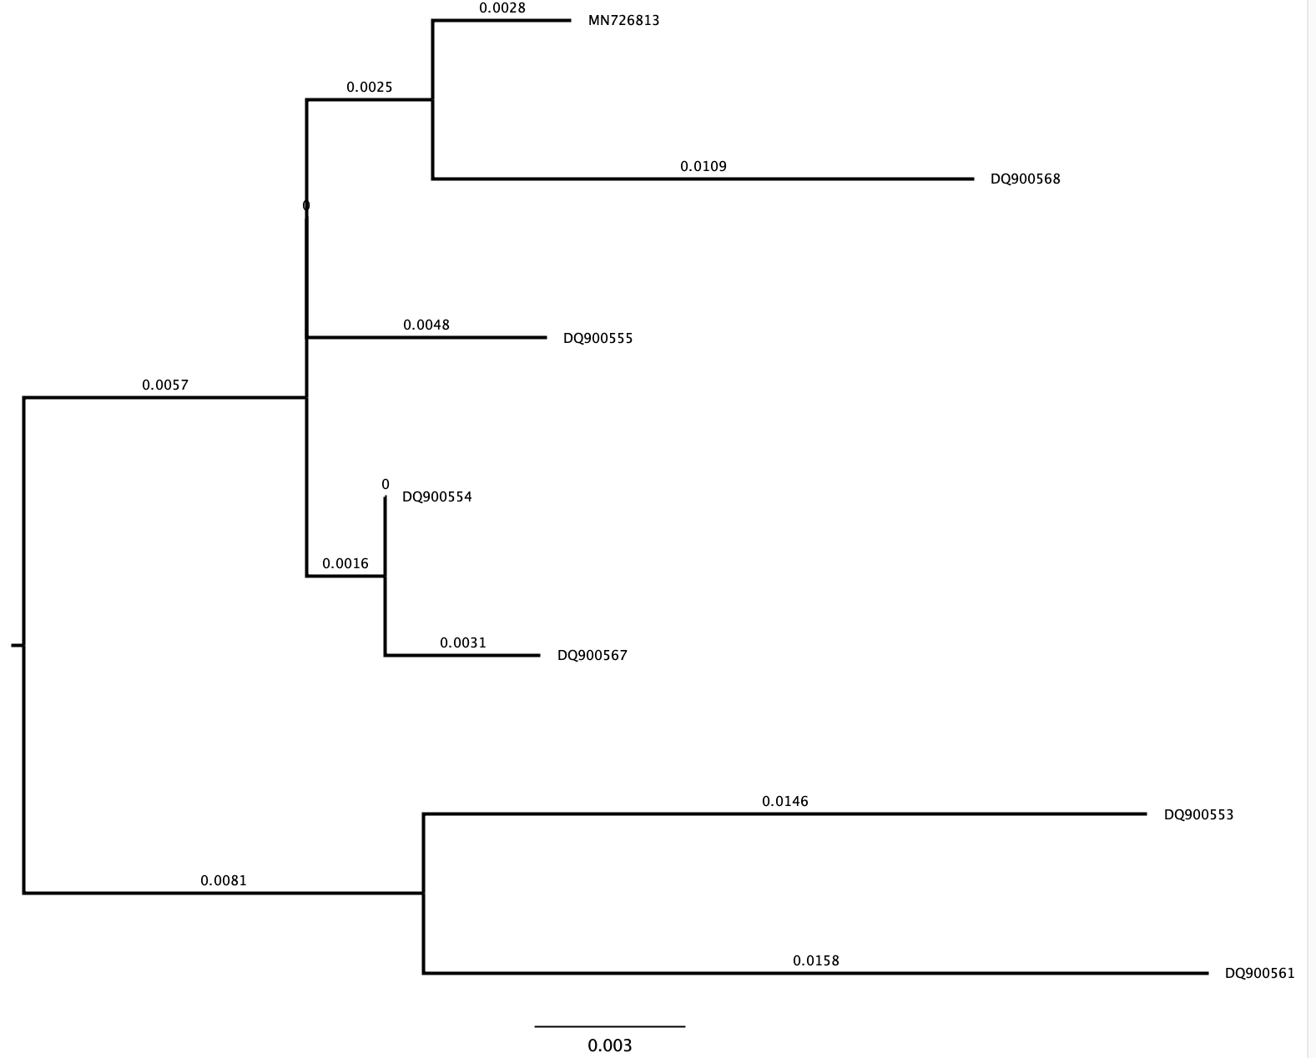
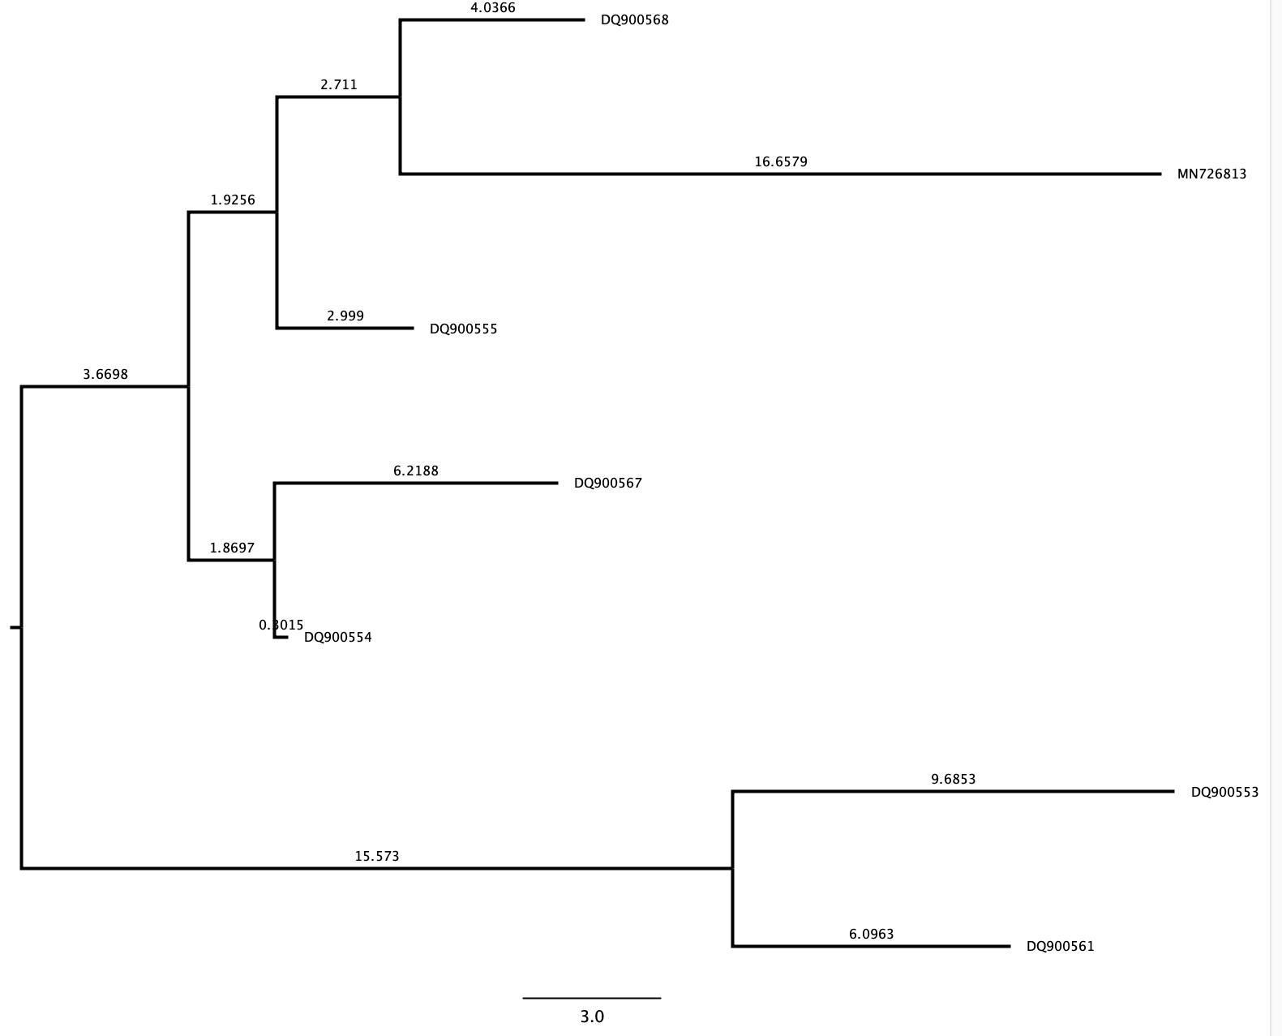
Units

Slide 24
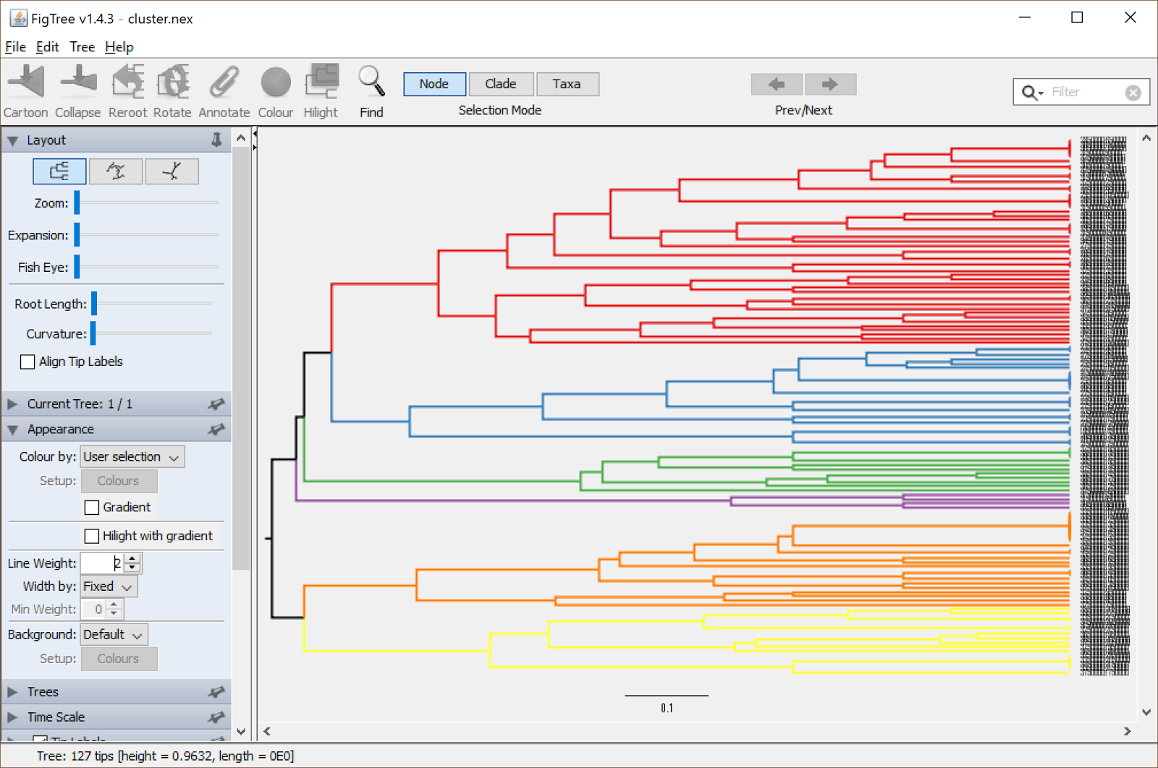
Adding Metadata
Can add useful information such as:
Species/host
Location
Lineage
Can help predict the location/host origin of a cluster

Slide 25
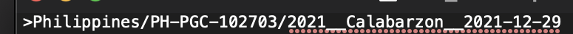
Adding Metadata
Ideally, we have a nicely formatted metadata table with information about all of our sequences. This isn’t always the case!
Sometimes the sequence ID contains useful information that needs to be extracted!
If all the IDs follow the same format, an automated pipeline to extract the information can be made!

Slide 26
Phylogenetic Analysis Steps
Collect homologous sequences
Conduct multiple alignment
Fit an appropriate substitution model
Estimate tree(s) under that model
Test the reliability of the estimated tree(s)
Interpret and apply the phylogenetic tree
Potentially repeat steps 4-6 using different tree building methods and/or additional data

Slide 27
Phylogenetic Analysis Steps
For the practical:
Follow instructions in day4_annotation.md
Collect homologous sequences
Conduct multiple alignment
Fit an appropriate substitution model
Estimate tree(s) under that model
Test the reliability of the estimated tree(s)
Interpret and apply the phylogenetic tree
Potentially repeat steps 4-6 using different tree building methods and/or additional data

Slide 28



Good luck, and happy tree building!
#UofGWorldChangers
@UofGlasgow
@ThatKatC

